Slide 1

FPGA based hardware implementation of bat algorithm Precious Onyenekwu Tatah university of the west of england bristol

Slide 2
Outline..
INTRODUCTION
BACKGROUND AND RELATED WORK
- Bat Algorithm
- Bat Algorithm application
- Position vector
- Velocity vector
- Frequency vector
- Loudness and pulse rate module
MAIN IDEA
- Hardware implementation of Bat Algorithm (flowchart)
- Pseudo random generator
- BA comparison with PSO
- Finite state machine
- Finite state machine of proposed algorithm

Slide 3
Outline contd
EXPERIMENTAL RESULTS
- sphere function
- rastrigin function
- rosenbrock function
- zakharov function
- implementation test
- BA comparison with other meta-heuristic algorithms
CONCLUSION
FURTHER STUDIES
PAPER EVALUATION
REFERENCES

Slide 4
Introduction/motivation
2 major computation concepts: evolutionary algorithms (e.g Genetic Algorithm (GA)) and swarm intelligence algorithm (E.G Particle swarm optimization (PSO), bee colony and bat algorithm).
The scope of this paper is to propose a novel hardware implementation of bat algorithm into FPGA circuit. This is experimented in many benchmark functions (sphere, rastrigin, rosenbrock and zakharov).
In other to solve many complex computing problems, digital solutions like FPGA were needed. They are also used as numerical targets for BA
BA’s ability and simplicity to solving complex real optimization problems for other algorithms makes the study active compared to other optimization techniques. By giving satisfactory results when solving difficult problems, the algorithm has proved to be effective.
BA requires high level synthesis tools to control a dynamic approach, it cannot be implemented using conventional design techniques. This is because the first implementations of digital BA were performed using microcontrollers, microprocessors and DSP’s but these solutions failed to give a good optimization at execution time.

Slide 5
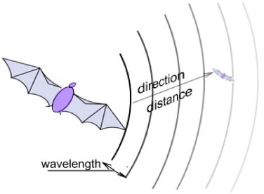
bat algorithm (ba)
Bat algorithm is a new meta-heuristic algorithm proposed by Xin-She Yang IN 2010 which is based on using echolocation for optimum solutions.
These echolocation calls are generally presented by: the pulse emission rate, the frequency and the loudness which are then collected and calculated in the brain to produce a virtual image of their environment.
The direction and intensity of the returned signal enables them to locate direction and distance of potential prey. Bats can also quickly differentiate between an obstacle and a prey.

Slide 6
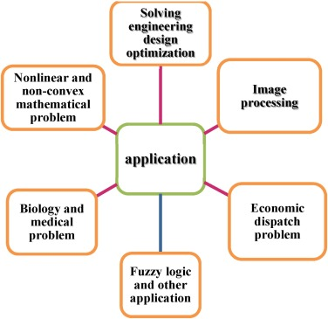
bat algorithm application
BA provides satisfactory results in solving many dispatch problems relating to the fig below.

Slide 7
bat algorithm…
In other to make a virtual image of the environment, bats use factors such as: the position vector, the velocity vector, the frequency vector and the loudness & pulse rate module.

Slide 8
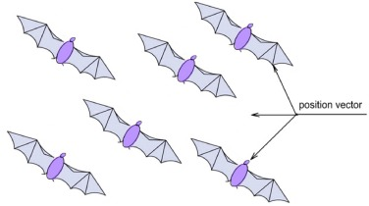
Position vector
The general objective of bat swarming is to indicate using their position, the distance of the best prey. Each bat is associated with a point in the search space depending on the intensity and frequency of the emitted sound wave made by the bat itself and its companions.
xi (t +1) = xi(t) + vi(t+1) Equation (1)
vi (t+1) = vi(t) + (xi(t) - Gbest) fi Equation (2)

Slide 9
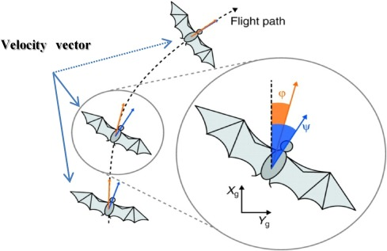
Velocity vector
At initialisation the bats are uniformly distributed in the search space with a general initial velocity of zero. They each fly using a velocity equation.
If amplitude and pulse rate perceived by the bat < the emitted loudness and > than the emitted rate = prey detection
Similar to the rule of PSO either the bat continues in its current path and new speed = The external velocity vector (frequency (fi) * current position * position of the best solution) + current velocity.
Or it changes directions then Position = current position of a randomly chosen bat. This position is obtained by adding a random perturbation proportional to the average power of the loudness emitted by all the bats.

Slide 10
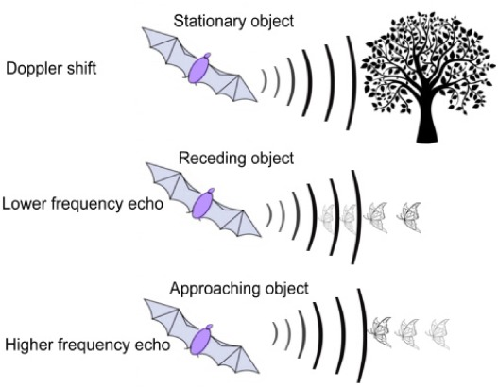
Frequency vector
Fi is the ith frequency bat, it is generated uniformly in the range of [fmin, fmax]. Fi allows controlling the rhythm of the movement. New velocity = new velocity + current position.
Fi is updated after every iteration using:
fi = fmin + (fmax - fmin) Bi Equation (3)
Equation 1, 2, 3 allow the diversity of the bat algorithm.
If no prey is detected, a global search is used in order to allow the exploitation of the search space using:
Xnew = Xold + eA^t Equation (4)
“e” is the ability to perceive emitted sound by other bats from the swarm. It is a random value between [-1,1]. “A” is the amplitude of the emitted sound allowing bats to perform a global exploration of their space.

Slide 11
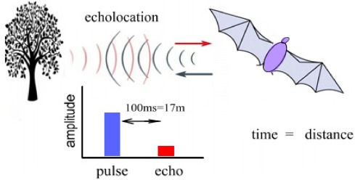
loudness & pulse rate module
In most implementations, the loudness is chosen in the interval [Amin=0, Amax=1]. Initial loudness and pulse rate value is generally set at 0.5 but It is also possible to initialise Ai and ri randomly.
Bats tend to increase pulse emission rate and decreasing the loudness (Ai) of the emitted sound when they are closer to their prey, this is modelled using:
Ai (t + 1) = aAi (t) Equation (5)
ri (t + 1) = ri (0) [1 – exp (- δt)] Equation (6)
According to these equations, the bat is moving towards optimal solution. Ri is varied once a solution is improved.

Slide 12
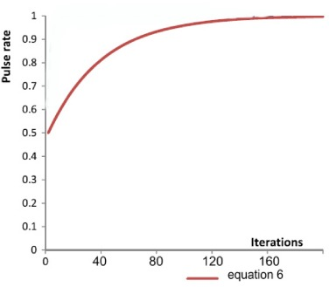
loudness & pulse rate module
Graphical comparison of EQ 6 by choosing r_{max} = 1.0, r_{i}(0) = 0.5, α = δ = 0.95 over an iteration number of 150

Slide 13
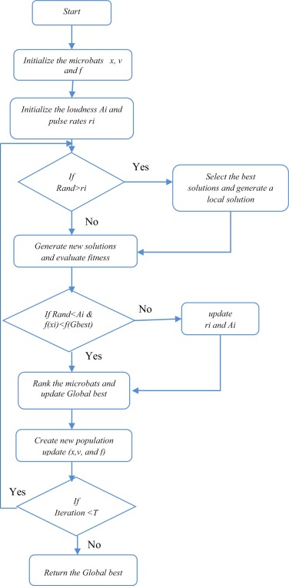
HARDWARE IMPLEMENTATION OF BA (FLOWCHART)
Proposed architecture of the Bat Algorithm

Slide 14
HARDWARE IMPLEMENTATION OF BAT
These parameters should be initialised before running the architecture:
- The size of the search space
- The position of the bats in our search space
- The velocity of the bats
- The best global fitness achieved of the microbats
- The position of the microbats to the solution
- The pulse rate and loudness of each microbats

Slide 15
Pseudo random generator
Pseudo random generator is an algorithm that generates a sequence of numbers with certain properties of chance. Because the numbers are assumed to be sufficiently independent of each other, it is suitable for implementation so it is easily and effectively used.
All parameters must be initialised with initial seed using pseudo random number module, then compared with the pulse rate (ri) and the rand is the random function implemented in the BA this is a value between 0 & 1.
In BA, pseudo random generators are used at the initial position of bats and in the velocity, loudness and frequency vector. And the frequently used pseudo random generator in BA is the linear congruent of Lehmer “Fn+1 = (AFn + B) mod C”.
D.H Lehmer introduced linear generators congruential in 1948. “C” is generally chosen to be equal of word length so in this case, C=16.
If (rand>ri) a new local bat is created by flying randomly to another position in the search space. Otherwise, another bat is created through random flying when its frequency is adjusted and its position and velocity is updated.

Slide 16
BA comparison with PSO
The architecture shows that BA shares a lot in common with PSO;
Both begin with a random generation using the random generator module.
Both evaluate population using a fitness module.
Both update the position of the population using the position module to search for an optimum solution.
Both use bloc memory

Slide 17
Finite state machine
This parallel BA implemented to be applied into large optimization problem increases convergence to a local minimum so to increase the performance of this algorithm, a finite state machine is used to exploit the maximum of parallelism.
In a dynamic parallel computing, the main factor of performance is the communication latency after each transition between states. In the proposed architecture, a pair memory module are used to compound the bandwidth so the capabilities of the algorithm can be effective.
Dual channel bloc RAM is recommended to be used which makes it possible access the data memory in two modes: write or read at the same frequency.
Drawback of the dual RAM: delay in memory reading time by one clock compared to the last reading. The soul of the parallel processing In this paper was used to generate a dynamic BA and the aim of using parallel computing to the bat algorithm, is to speed up the algorithm processing using a uniform distribution method to achieve optimum solutions with a significant execution time.

Slide 18
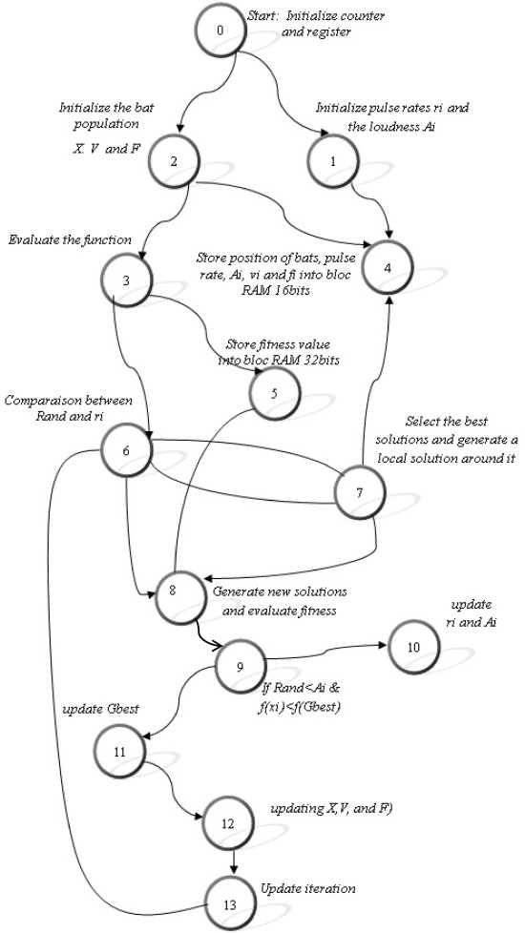
THE FINITE STATE MACHINE OF THE PROPOSED ALGORITHM
Yang demonstrates that the choice of upper and lower bounds for echolocation parameters might have some significant influence on convergence characteristics of the bat algorithm.
Initialised bounds in this paper: fmin= 0, fmax= 1, rmin=0.5, Amax= 1. Every bat includes some parameters: B= (fi, ri, Ai). All positive dynamic values with value interval
r_{min} < r_{i} < r_{max}, f_{min} < f_{i} < f_{max}, A_{min} < A_{i} < A_{max}
In this algorithm, the initial frequency value f_{i}(0) is fixed randomly between f_{min} and f_{max} , initial loudness A_{i}(0) is fixed initially to its maximum number A_{max} = 1 and the initial pulse rate r_{i}(0) is fixed to its minimum value r_{min} = 0.5 for each bat.

Slide 19
Experimental Results - Sphere function
Used to calculate the characteristics of optimization algorithms such as the robustness and velocity of convergence. It has a local minimum, it is continuous and unimodal. Interval of search space is between [-1,1].
Device utilization summary (estimated values)
Logic utilization | Used | Available | Utilization(%)
Number of slices | 602 | 1920 | 31%
Number of slice flip flops | 568 | 3840 | 14%
Number of 4 input LUTs | 1010 | 3840 | 26%
Number of IOBs | 18 | 173 | 12%
Number of BRAMs | 5 | 12 | 41%
Number of MULT18 × 18s | 4 | 12 | 33%
Number of GCLKS | 7 | 8 | 87%

Slide 20
Rastrigin function
This function contains several local minima but just one global minimum. Highly multimodal and the minima locations are regularly distributed.
Device utilization summary (estimated values)
Logic utilization | Used | Available | Utilization(%)
Number of slices | 1162 | 1920 | 60%
Number of slice flip flops | 1001 | 3840 | 26%
Number of 4 input LUTs | 1690 | 3840 | 44%
Number of IOBs | 18 | 173 | 10%
Number of BRAMs | 5 | 12 | 41%
Number of MULT18 × 18s | 5 | 12 | 41%
Number of GCLKS | 8 | 8 | 100%

Slide 21
Rosenbrock function / the banana function name
Introduced by Howard H. Rosenbrock in 1960, it’s a non-convex function of two variables, used as a test for mathematical optimization problems. Here the global minimum of search algorithms converge easily and the global minimum is obtained at (x,y) = (1,1), for which the function is 0.
In other to increase the BA performance, a bloc memory is added to save the local best of bats and in this case the operating speed of the algorithm is increased.
Device utilization summary (estimated values)
Logic utilization | Used | Available | Utilization(%)
Number of slices | 1152 | 1920 | 60%
Number of slice flip flops | 1097 | 3840 | 28%
Number of 4 input LUTs | 1774 | 3840 | 46%
Number of IOBs | 18 | 173 | 10%
Number of BRAMs | 7 | 12 | 58%
Number of MULT18 × 18s | 7 | 12 | 58%
Number of GCLKS | 8 | 8 | 100%

Slide 22
Zakharov function
Here, the global minimum occurs at (x = 0). It has no local minima except the global one. It is two-dimensional form.

Slide 23
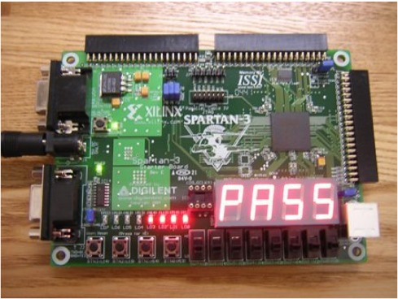
Implementation test
Spartan 3 kit is one of the best low cost generation of FPGA’s from Xilinx. The board can offers a choice of many platforms which deliver a unique cost optimization balanced between programmable logic, connectivity and devoted hard IP for many hardware applications. It creates a PROM (programmable read only) file and this latter can be written to the non-volatile memory.
The kit of Spartan-3 contain a lot of I/O signals, logic cell, 12 of hardware multipliers, 200k gate the following, 4 Digital extern clock and other features.
The implementation of bat algorithm in kit xc3s200 is done with a specific Digilent cable which is straight compatible with the Xilinx iMPACT software and it loads the bit-stream into the prom of FPGA.
The photo below was taken during the BA experiment, It presents two modes of display for the tested algorithm;
- Four seven segments module to display the number of iterations used in the algorithm when optimal solution tends to “0”
- In the second display, there are diodes LEDs used for the code of global best which composed from 16 bits. The 8 most significant bits are displayed first, then an action on the push button displays the 8 low significant bits of this global best.

Slide 24
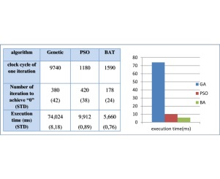
BA COMPARISON with other algorithms
The results are favourable and proved that bat algorithm can be effective for many problems related to any algorithms used.
The experiment results was carried out at minimum 5% which allow judging whether the results of the bat are acceptable and optimized in execution time compared to the best results of other algorithms.
The tests were done with the example of sphere function and the three algorithms are implemented on the same kit.
Execution time depends on the number of iterations allocated to achieve the solution.

Slide 25
Conclusion
The article develops a dynamic process of the Bat Algorithm and presents its hardware architectures' implementation in a Xilinx spartran3.
A finite state machine is used to exploit all the parallelisms that make the program converge very quickly.
BA has superior features such as;
- quality of solution,
- good computational efficiency
- stable convergence characteristics.
Based on the comparison the BA performs better than the PSO and GA.
The proposed architecture proves that it has a favourable convergence speed compared to the most of other meta-heuristic techniques.
The BA’s robustness is attached to its enhanced ability to achieve a satisfaction between two requirements, the size of memory and the processing time of algorithm to solve complex problems. Therefore, bat optimization is a promising technique for solving complicated problems in the real world applications.

Slide 26
Further studies
Apply the Bat Algorithm to different practical applications in further studies.
Further study using another kit like virtex 6 which consists of several memories with very fast operating/clock speed. Processing time of the algorithm will be reduced and display problem could also reduced or fixed.
The effects of different transfer functions on the performance of BA are also worth investigating. It supports the usage of the BA in further experiments and in further real world applications.

Slide 27
Paper Evaluation
Vague introduction is very vague i.e. information in this regard is limited.
The results are not well explained, the paper does not show how they arrived to certain numbers and figures using the formulas provided. Therefore, it doesn’t help in terms of general understanding?

Slide 28
REFERENCES
Sadok Ben Ameur, M, 2017. FPGA based hardware implementation of Bat Algorithm. Applied Soft Computing, [Online]. 58, 1-10. Available at: https://www.sciencedirect.com/science/article/pii/S1568494617301874 [Accessed 8 November 2018].
X.-S. Yang, J.R. Gonzalez. A new meta-heuristic bat Inspired algorithm. Nature Inspired Cooperative Strategies for Optimization (NISCO 2010) Studies in Computational Intelligence, Springer, Berlin (2010)

